Slide 1







KitchenSync
Team Neon Nomads

Slide 2

Agenda
01
02
03
04
Introduction
Improvements from last feedback
Project Description
Team Members Roles and Responsibilities
05
06
Personas
Teamworking Agreement
07
08
MVP
Technologies and Languages
09
10
Diagrams
Algorithms
11
12
Sprint 3 Recap
Product Backlog

Slide 3
Agenda
13
14
15
16
Sprint Summary
Sprint 4 Backlog
Test Cases
Stories Completed
17
18
Stories Not Completed
Team Velocity and Committed Ratio
19
Burndown Chart
20
Retrospective
21
WebApp Screenshots
22
GitHub Link
23
Live Application

Slide 4

Improvements from Last Feed Back
1
Explained how the technologies are used
Included user stories in test cases for reference.
Added Sprint 4 User stories

Slide 5





Introduction
02
KitchenSync is a comprehensive platform designed to make meal planning and pantry management a simple part of your daily routine. It's not just another tool for organizing the kitchen. Whether you're a working professional with a hectic schedule or a parent balancing the obligations of family life, KitchenSync is here to make your kitchen experience more efficient.

Slide 6
Project Description
03
KitchenSync streamlines your pantry management and meal planning seamlessly.
For those with active lifestyles and families
who find it challenging to keep up with their pantry inventory and curb food disposal,
the KitchenSync
is a sophisticated kitchen assistance platform,
that enhances the management of your pantry and offers recipe options that fit your available ingredients, organizes meal plans, and reminds you of the shelf life of your food items,
unlike conventional inventory systems and static shopping list apps
our application intelligently adapts to your dietary preferences and schedule, guaranteeing the optimal use of your groceries and simplifying the meal preparation process.

Slide 7


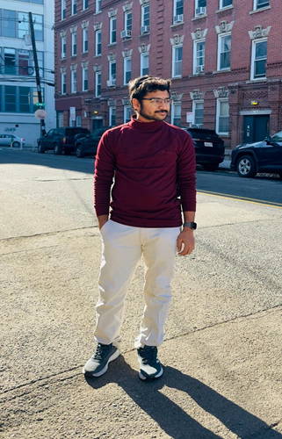


Team Members & Roles
04
Hemanvitha
Mylapalli
Shashank Akavaram
Yuga Kapil Krishna
Maytheramatla
Neha Srinivasaiah
Frontend Developer
Team Leader
Frontend Developer
Scrum Master
Backend Developer
Devops Engineer

Slide 8

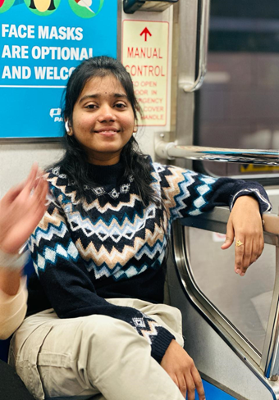


Team Members & Roles
Bala Sahithi
Kamana
Aditya Gadhave
Sasank
Nannapaneni
Sujitha Chethireddy
Software Developer
Backend Developer
Software Developer
Software Test Engineer

Slide 9

Teamwork Agreement
05
The goal of our Teamwork Agreement is to establish expectations for behavior in an attempt to foster collaboration and productivity.
The specific roles and responsibilities of each member may vary as the project progresses.
One meeting per week is scheduled for Saturdays, and daily meetings are held for Scrum. Important decisions will be made collectively, documented, and shared with all participants.
Agendas are distributed beforehand by WhatsApp or email.

Slide 10



Personas
06
A persona is an imaginary client that personifies the traits of a subset of your customers. For the purpose of creating your product or service, the Persona provides useful information about those clients' demographics. Their objectives, driving forces, and constraints.

Slide 11



Persona 1
Cael 21 years old, freshman
Background: A freshman at Pace University from a low-income family living in a dormitory. He’s on a tight budget and needs to make his grocery shopping as efficient as possible.
Personality: Cheerful, disciplined, hardworking, initiative
Pain points: Limited budget, inexperience in meal planning, difficulty in finding recipes.
Challenges:
Unnecessary purchase, eating healthy, managing a small food storage.

Slide 12



Persona 2
Ella 32 years old, Advocate
Background: Ella is an advocate who is leading a busy lifestyle. She is health conscious and enjoys cooking nutritious meals at home.
Personality: Altruistic, organized, passionate, perseverance
Pain points: Managing her schedule, locating recipes that meet specific dietary preferences, keeping track of expiration dates
Challenges:
Efficiently organizing pantry items, meal planning

Slide 13



Persona 3
Michelle 44 years old, Busy Mom
Background: Michelle is a working mom of four. She juggles between a demanding job and household responsibilities.
Personality: Empathetic, forgiving, nurturing, patience
Pain points: Balancing a demanding job and household responsibilities, over-purchasing, and desire for a system to assist with a recipe suggestion
Challenges:
Coordinating meals to fit into a busy schedule, managing a large and diverse food inventory, and reducing food wastage.

Slide 14
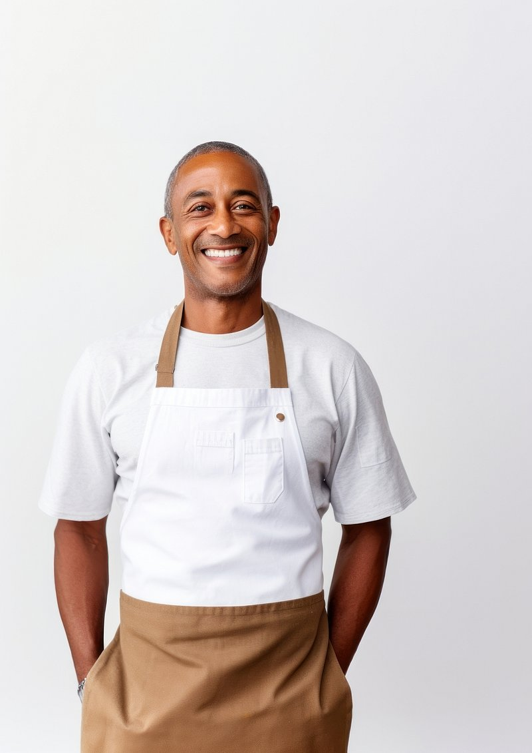


Persona 4
Diego 49 years old, Restaurant Manager
Background: Diego manages a small restaurant specializing in local cuisine. He’s constantly balancing various tasks and often overlooks inventory management, leading to occasional food wastage.
Personality: Creative, Community-Minded, Entrepreneurial, Passionate
Pain points: overlooking inventory management due to multitasking, the need for a system to suggest recipes and expiration alerts.
Challenges:
Streamlining inventory management and reducing food wastage.

Slide 15
MVP(Minimal Viable Product)
07
Minimal Viable Product (MVP) for the KitchenSync application will include core functionalities such as user authentication, pantry management, food image upload with nutritional prediction using a pre-trained model like MobileNet, recipe suggestions based on pantry contents, and expiry date alerts. The application will be developed using Python with Flask for the backend, HTML, CSS, and JavaScript for the front end, and SQLite for the database. This MVP focuses on essential features to manage and optimize kitchen activities effectively while allowing for future enhancements.

Slide 16






Technologies and Languages
08
HTML
CSS
JavaScript
Python
Flask
Craft the user interface, ensuring a responsive and interactive experience for managing pantry items and viewing recipes.
Serve as the core for backend operations, managing server logic and data handling.

Slide 17



Technologies and Languages
08
Provides a lightweight database solution for storing user data and pantry items.
SQLite
Used for development, offering powerful coding, testing, and debugging tools.
VS Code
Manages version control, supporting collaborative development efforts.
GitHub

Slide 18


Technologies and Languages
08
Tracks tasks and progress in the development process using agile methodologies.
Jira Board
Manages Python environments, ensuring consistent handling of dependencies, particularly for machine learning features.
Anaconda

Slide 19



Algorithms and Libraries
09
Tensorflow
Keras
Scikit Learn
Tensorflow and Keras are used for food image recognition, enabling the app to identify food items from images and provide recipe suggestions and nutritional information.
Scikit Learn is used for recommending recipes based on pantry ingredients and for predictive analytics to forecast pantry needs and optimize grocery shopping.

Slide 20
Algorithms and Libraries
09
MobileNet Models are deep learning models optimized for mobile and edge devices. In our project, we used MobileNet for image recognition tasks, such as identifying identifying recipe and nutritional value of the food item from the uploaded image.
K-Nearest Neighbors is a simple, versatile machine-learning algorithm used for classification and regression. We used KNN to suggest recipes by finding the closest match to the uploaded image.
VGG16 is a convolutional neural network model known for its effectiveness in image recognition. VGG16 was utilized for analyzing images of food to help with recipe generation.

Slide 21
Algorithms and Libraries
09
Random Forest is an ensemble learning method used for classification and regression. This algorithm is deployed to predict the nutritional values of uploaded items of food.
Web Scraping was used to gather recipes from the internet to find appropriate recipes and their nutritional values.

Slide 22
Diagrams
10
Architecture Diagram
Context Diagram
ER Diagram
Sequence Diagram
State Diagram
Class Diagram

Slide 23
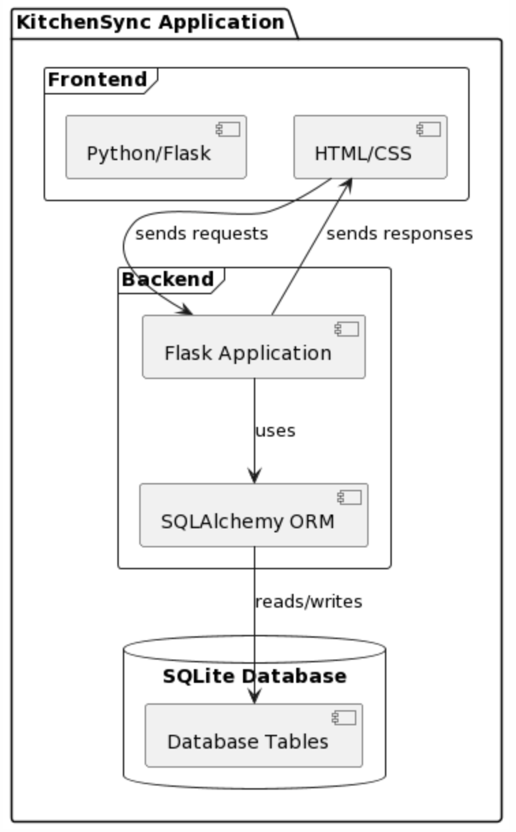
Architecture Diagram

Slide 24
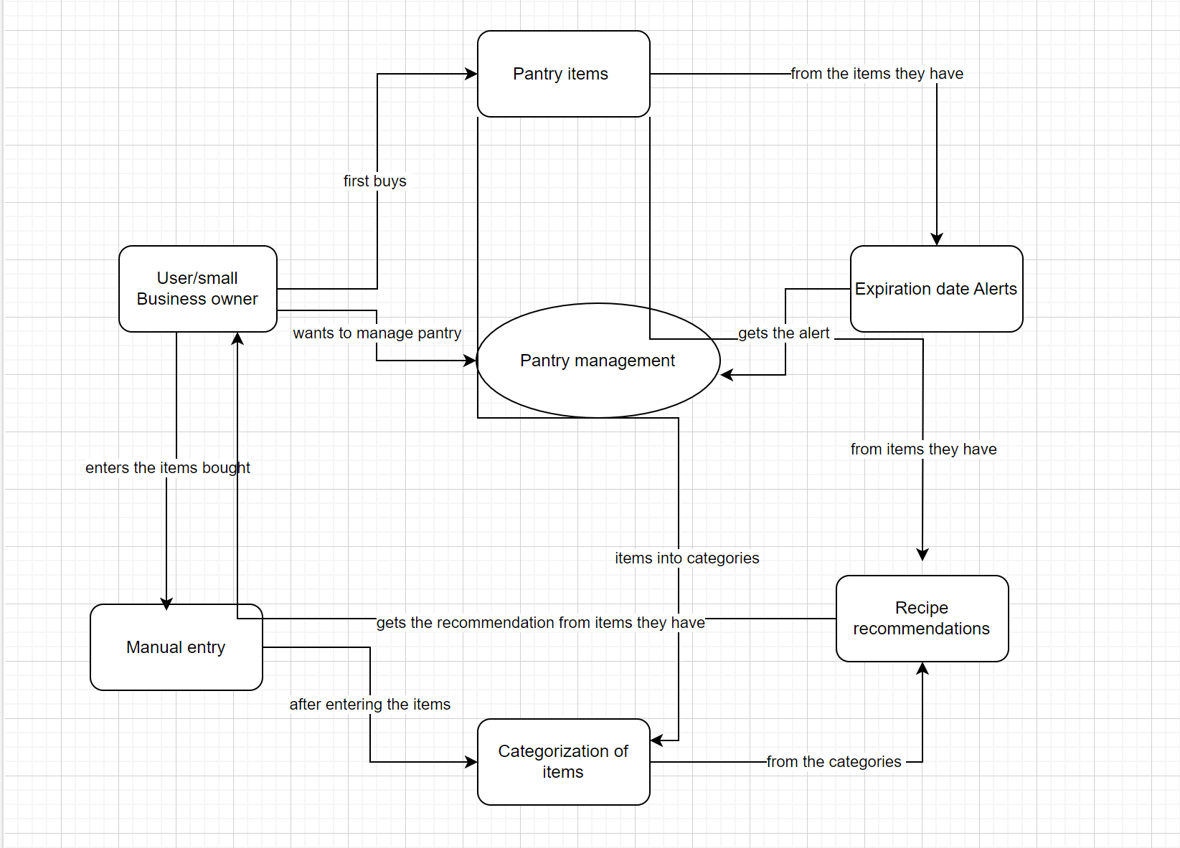
Context Diagram

Slide 25
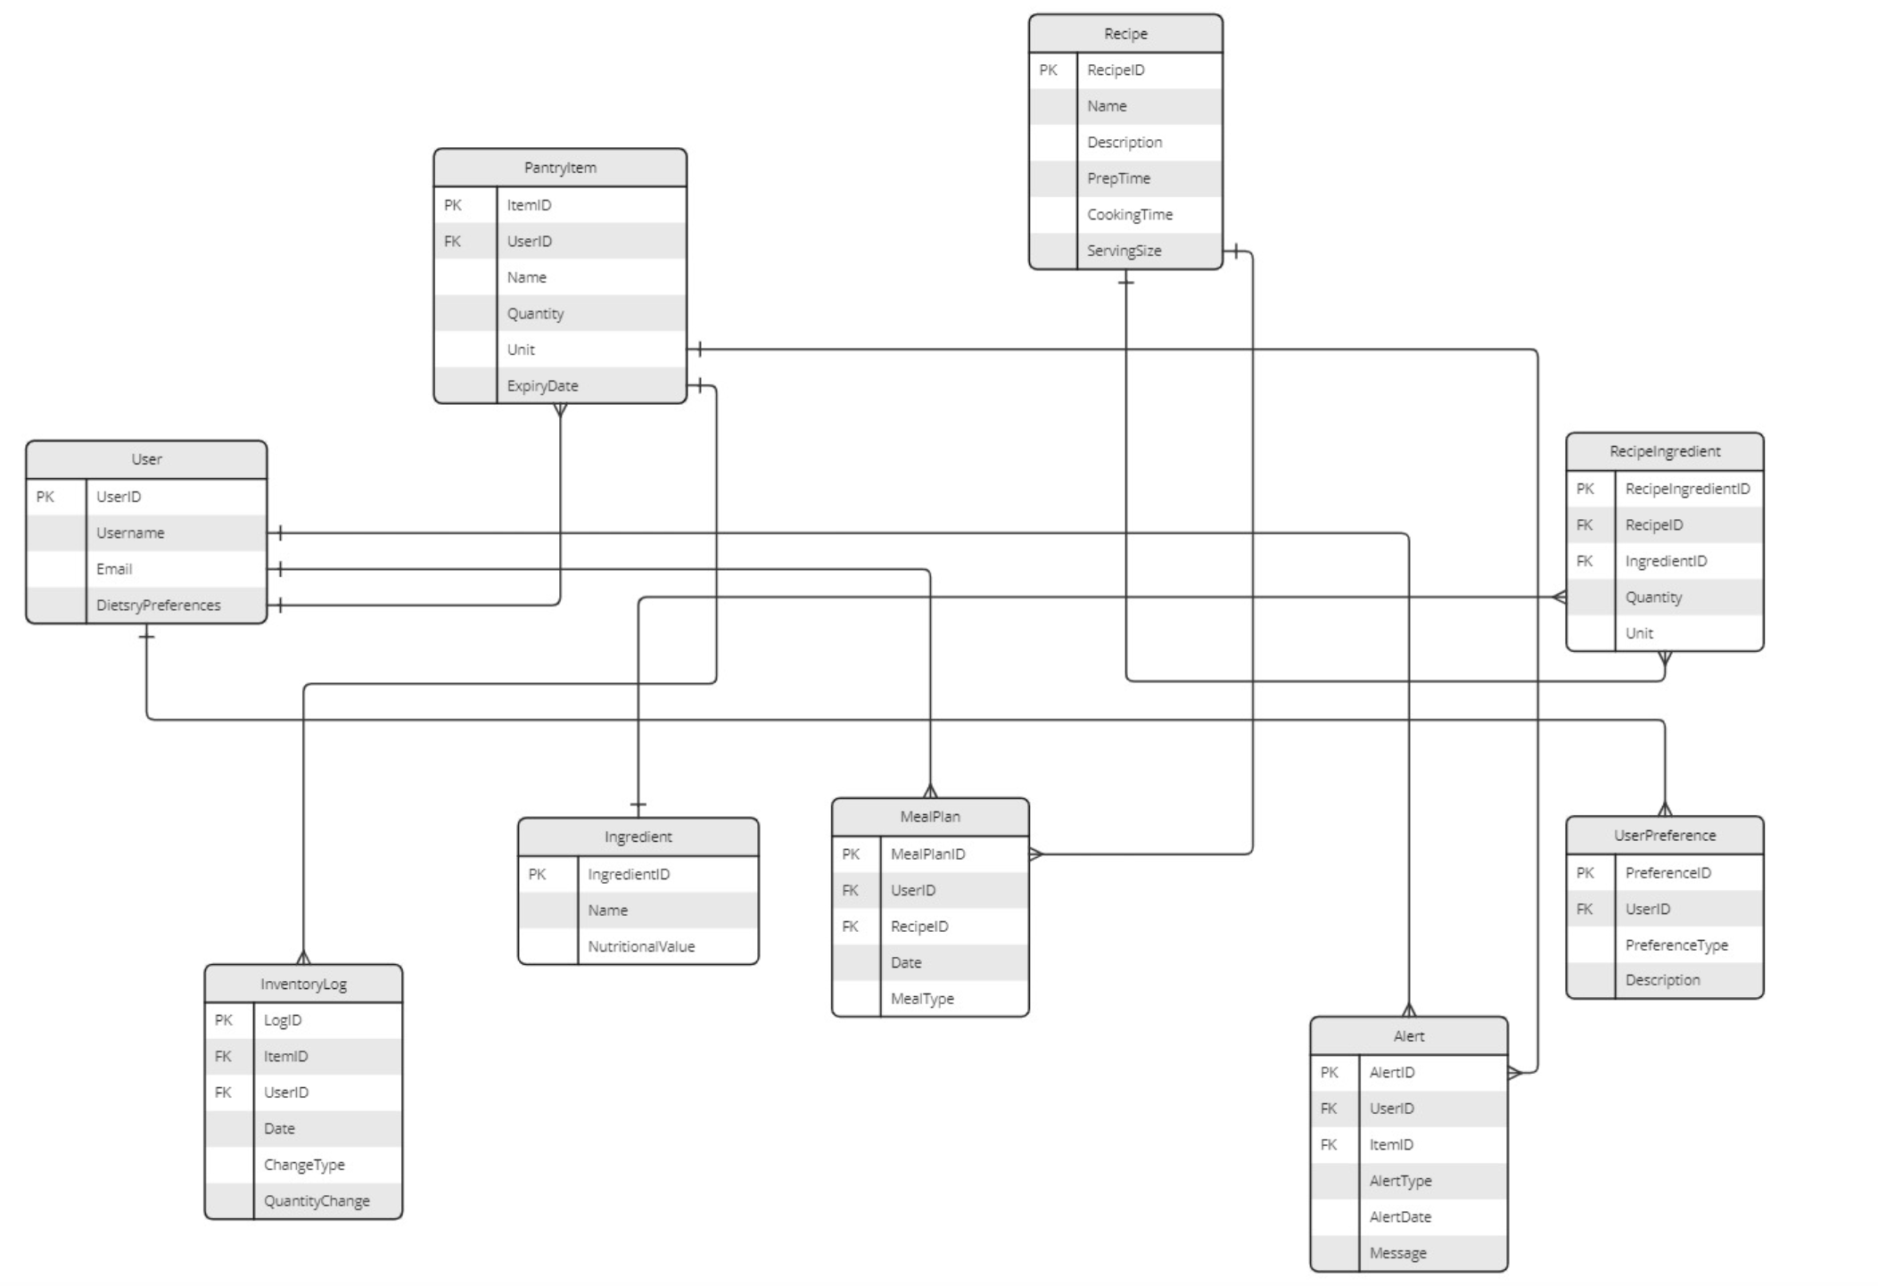
ER Diagram

Slide 26
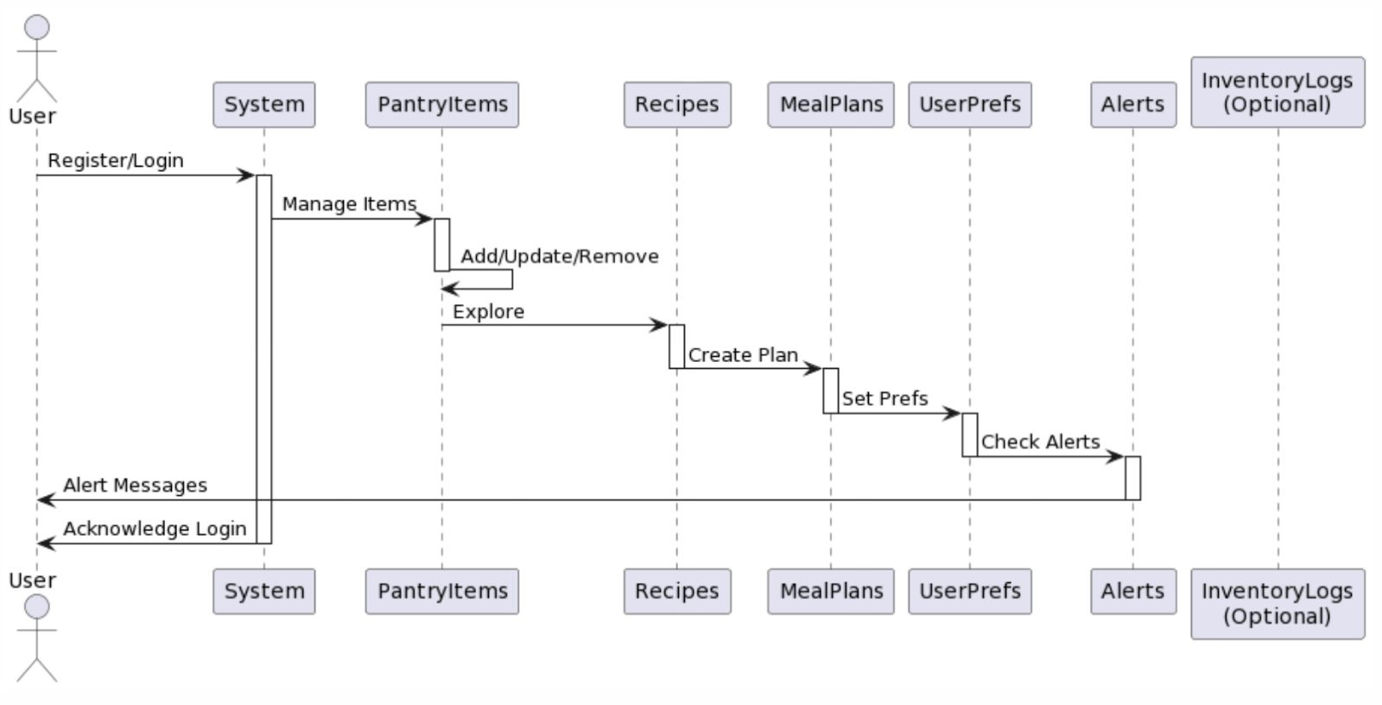
Sequence Diagram

Slide 27
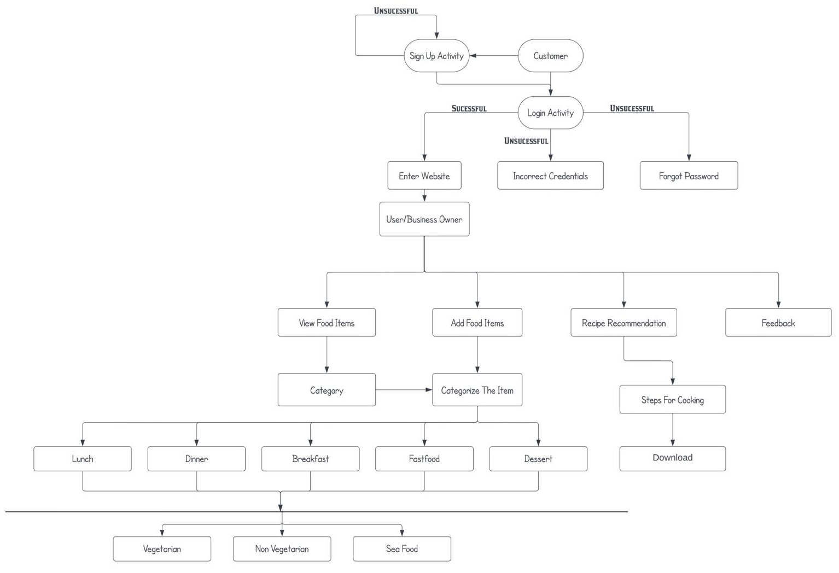
State Diagram

Slide 28
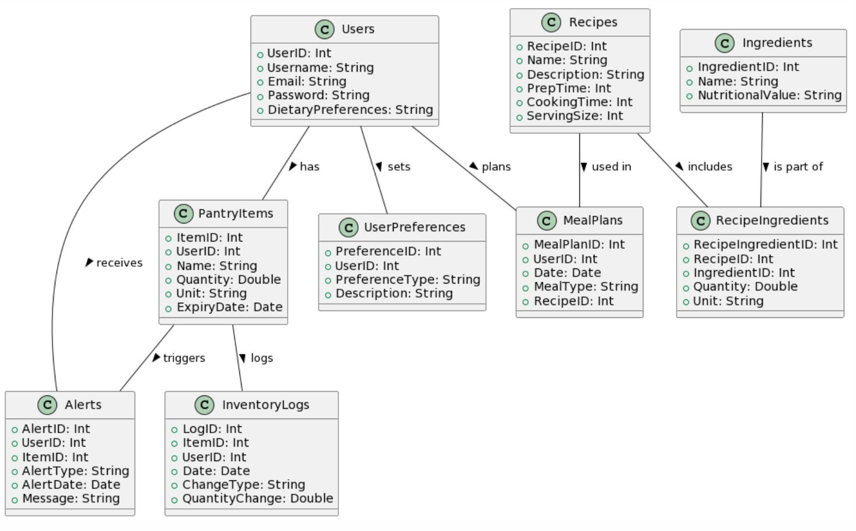
Class Diagram

Slide 29
Sprint 3 Recap
11
Sprint 3
Estimation | User Id | As a | I want to | So that | Feature
5 | 3 | Health-conscious Individual | check the nutritional value | I can maintain my dietry regimen without hassle | Nutritional Value
2 | 5 | Gourmet Cook | access a wide variety of recipes | I can explore new dishes and cuisines | Recipe Recognizer
8 | 6 | Parent with multiple kids | plan meals for the whole week | I can organize my shopping and cooking schedule better | Recipe Recognizer
8 | 7 | Novice Cook | have step-by-step cooking guides | I can learn to cook with more confidence | Recipe Recognizer
1 | 9 | College Student | find recipes based on the ingredients I have | I can avoid buying extra groceries | Recipe Recognizer
2 | 13 | Restaurant Chef | access a wide variety of recipes | I can quickly offer my dishes | Recipe Recognizer

Slide 30
Product Backlog
12
Estimation | User Id | As a | I want to | So that | Feature
13 | 1 | Student | upload an image of food | I can receive video recipes related to the image | Recipe Recommendation
8 | 2 | Parent | see detailed nutritional information for the food in the uploaded image | I can make informed dietary choices | Nutritional Value
5 | 3 | Health-conscious Individual | check the nutritional value | I can maintain my dietry regimen without hassle | Nutritional Value
8 | 4 | Environmentally Aware User | be alterted about food nearing expiration | I can reduce food waste | Expiry Notifications
2 | 5 | Gourmet Cook | access a wide variety of recipes | I can explore new dishes and cuisines | Recipe Recognizer
8 | 6 | Parent with multiple kids | plan meals for the whole week | I can organize my shopping and cooking schedule better | Recipe Recognizer
8 | 7 | Novice Cook | have step-by-step cooking guides | I can learn to cook with more confidence | Recipe Recognizer

Slide 31
Product Backlog
12
Estimation | User Id | As a | I want to | So that | Feature
1 | 9 | College Student | find recipes based on the ingredients I have | I can avoid buying extra groceries | Recipe Recognizer
5 | 10 | Bakery Owner | manage my inventory of baking ingredients | I can prevent shortages and reduce excess waste | Inventory Management
8 | 11 | Restaurant Manager | track the freshness of my perishable stock | I can ensure the quality of the dishes served | Freshness Tracking
3 | 12 | Pastry Chef | receive alerts when specific ingredients are low | I can reorder supplies in time for baking | Expiry Notifications
2 | 13 | Restaurant Chef | access a wide variety of recipes | I can quickly offer my dishes | Recipe Recognizer
5 | 14 | Head Chef | update my inventory | I can keep track of what I have | Inventory Management
1 | 15 | Restaurant Owner | I want to create an account | I can add items to my inventory | Inventory Management
5 | 16 | Seafood Market Manager | track the sell-by dates of seafood | we can guatantee the freshness and safety of our products | Expiry Notifications

Slide 32
Sprint Summary
13
Sprint 2
Estimation | User Id | As a | I want to | So that | Feature
5 | 10 | Bakery Owner | manage my inventory of baking ingredients | I can prevent shortages and reduce excess waste | Inventory Management
5 | 14 | Head Chef | update my inventory | I can keep track of what I have | Inventory Management
1 | 15 | Restaurant Owner | I want to create an account | I can add items to my inventory | Inventory Management

Slide 33
Burndown Chart – Sprint 2
13
Story Points
Days

Slide 34
Sprint Summary
13
Sprint 3
Estimation | User Id | As a | I want to | So that | Feature
5 | 3 | Health-conscious Individual | check the nutritional value | I can maintain my dietry regimen without hassle | Nutritional Value
2 | 5 | Gourmet Cook | access a wide variety of recipes | I can explore new dishes and cuisines | Recipe Recognizer
8 | 6 | Parent with multiple kids | plan meals for the whole week | I can organize my shopping and cooking schedule better | Recipe Recognizer
8 | 7 | Novice Cook | have step-by-step cooking guides | I can learn to cook with more confidence | Recipe Recognizer
1 | 9 | College Student | find recipes based on the ingredients I have | I can avoid buying extra groceries | Recipe Recognizer
2 | 13 | Restaurant Chef | access a wide variety of recipes | I can quickly offer my dishes | Recipe Recognizer

Slide 35
Burndown Chart – Sprint 3
13
Story Points
Days

Slide 36
Sprint 4 Product Backlog
14
User ID | User Story | Acceptance Criteria
1 | As a student I want to upload an image of the food so that I can receive video recommendations of the image uploaded | Given the system has identified the food in the image, When it fetches recipe videos, Then it should display atleast four relevant recipe videos
2 | As a parent I want to see detailed nutritional information for the uploaded food image so that I can make informed dietary choices | Given the system has processed the uploaded food image, When the analysis identifies the food item, Then it should display detailed nutritional information including calories, fats, protiens, carbs and any significant vitamins and minerals
4 | As an Environmentally Aware User, I want to be alerted about food nearing expiration so that I can reduce food waste | Given I want to minimize food waste due to expired products, When I check the KitchenSync app, Then it should provide a prioritized list of items to use based on their expiration dates, with recipes suggestions when applicable.
11 | As a Restaurant Manager, I want to track the freshness of my perishable stock so that I can ensure the quality of the dishes served | Given I am a restaurant manager responsible for maintaining the freshness of perishable goods, When I store new stock in the inventory using the KitchenSync app, Then the app should track the shelf life and alert me a few days before the expiration date.
12 | As a Pastry Chef, I want to receive alerts when specific ingredients are low so that I can reorder supplies in time for baking | Given I need to ensure continous availabity of baking ingredients, When I review my upcoming baking schedule and current inventory in the KitchenSync app, Then the app should provide a forecast of ingredient usage and alert me in advance if I need to reorder to meet demand.
16 | As a Seafood Market Manager, I want to track the sell-by dates of seafood so that we can promote the freshness and safety of our products | Given a seafood product is approaching it's sell-by date, When I check the inventory in the KitchenSync app, Then the app should highlight the product and alert ne so I can prioritize its sale to ensure freshness and safety.

Slide 37
Test Cases
15
Test Id | User Story | Description | Outcome
NUT_VAL | As a parent I want to see detailed nutritional information for the uploaded food image so that I can make informed dietary choices | Verify if the nutritional values of the uploaded image | Successful viewing of nutritional values
REC_VI | As a student I want to upload an image of the food so that I can receive video recommendations of the image uploaded | Verify if the system recommends top 4 recipe videos | Recipe Video recommendations
REC_RECOM | As a Bakery Owner I want to manage my inventory of baking ingredients so that I can prevent shortages and reduce excess waste | Test recipe recommendations by uploading an image | Successful recipe recommendation
USER_ALT_GEN | As a Pastry Chef, I want to receive alerts when specific ingredients are low so that I can reorder supplies in time for baking | Verify alert generation for items that are approaching expiry dates. | Successful alert generation
USER_ALT_TIME | As a Restaurant Manager, I want to track the freshness of my perishable stock so that I can ensure the quality of the dishes served | Time frames for when the alerts should be sent. | Successfully setting Time frames for alerts
USER_REC | As a Gourmet Cook, I want to access a wide variety of recipes so that I can explore new dishes and cuisines | Test recipe recognizer when you upload an image | Successful recipe recognition

Slide 38
Stories Completed
16
Estimation | User Id | As a | I want to | So that | Feature
13 | 1 | Student | upload an image of food | I can receive video recipes related to the image | Recipe Recommendation
8 | 2 | Parent | see detailed nutritional information for the food in the uploaded image | I can make informed dietary choices | Nutritional Analysis
8 | 4 | Environmentally Aware User | be alterted about food nearing expiration | I can reduce food waste | Expiry Notifications
8 | 11 | Restaurant Manager | track the freshness of my perishable stock | I can ensure the quality of the dishes served | Freshness Tracking
3 | 12 | Pastry Chef | receive alerts when specific ingredients are low | I can reorder supplies in time for baking | Expiry Notifications
5 | 16 | Seafood Market Manager | track the sell-by dates of seafood | we can guarantee the freshness and safety of our products | Expiry Notifications

Slide 39
Stories Not Completed
17
We finished everything we initially planned

Slide 40
Team Velocity and Committed Ratio
18
Team Velocity = Total number of story points completed in this sprint
Team Velocity Sprint 4 = 45
Sprint 2 Team Velocity = 11, Sprint 3 Team Velocity = 26
Historical Team Velocity = Average of previous sprint’s velocity
Historical Team Velocity = (11+26+45)/3 = 27.33
Committed Ratio
Committed Ratio = 45/45 = 100%

Slide 41
Burndown Chart – Sprint 4
19
Story Points
Days

Slide 42
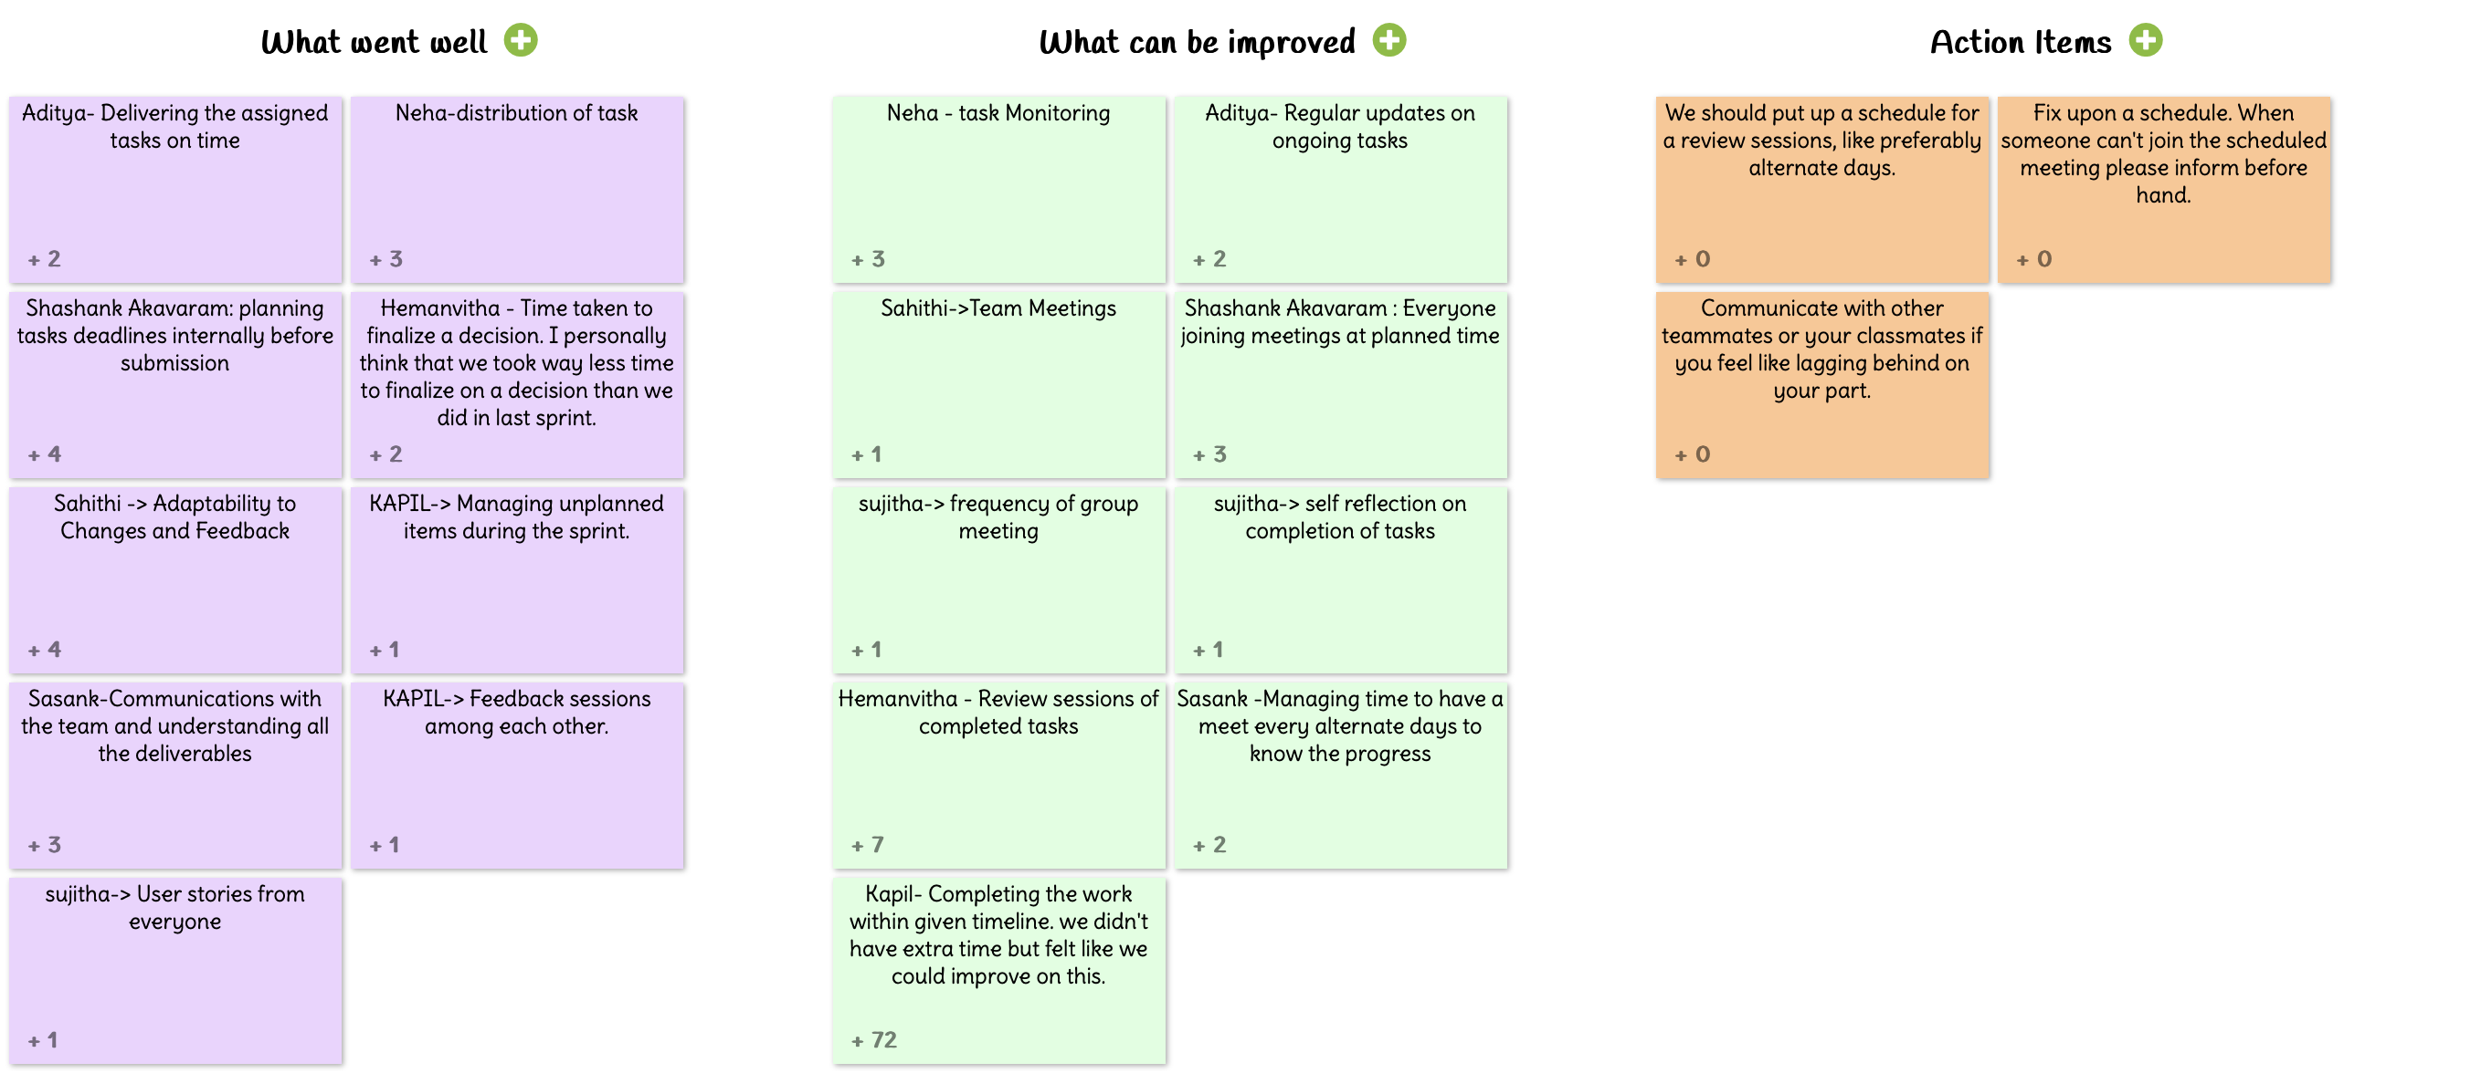
Retrospective – Sprint 2
20

Slide 43
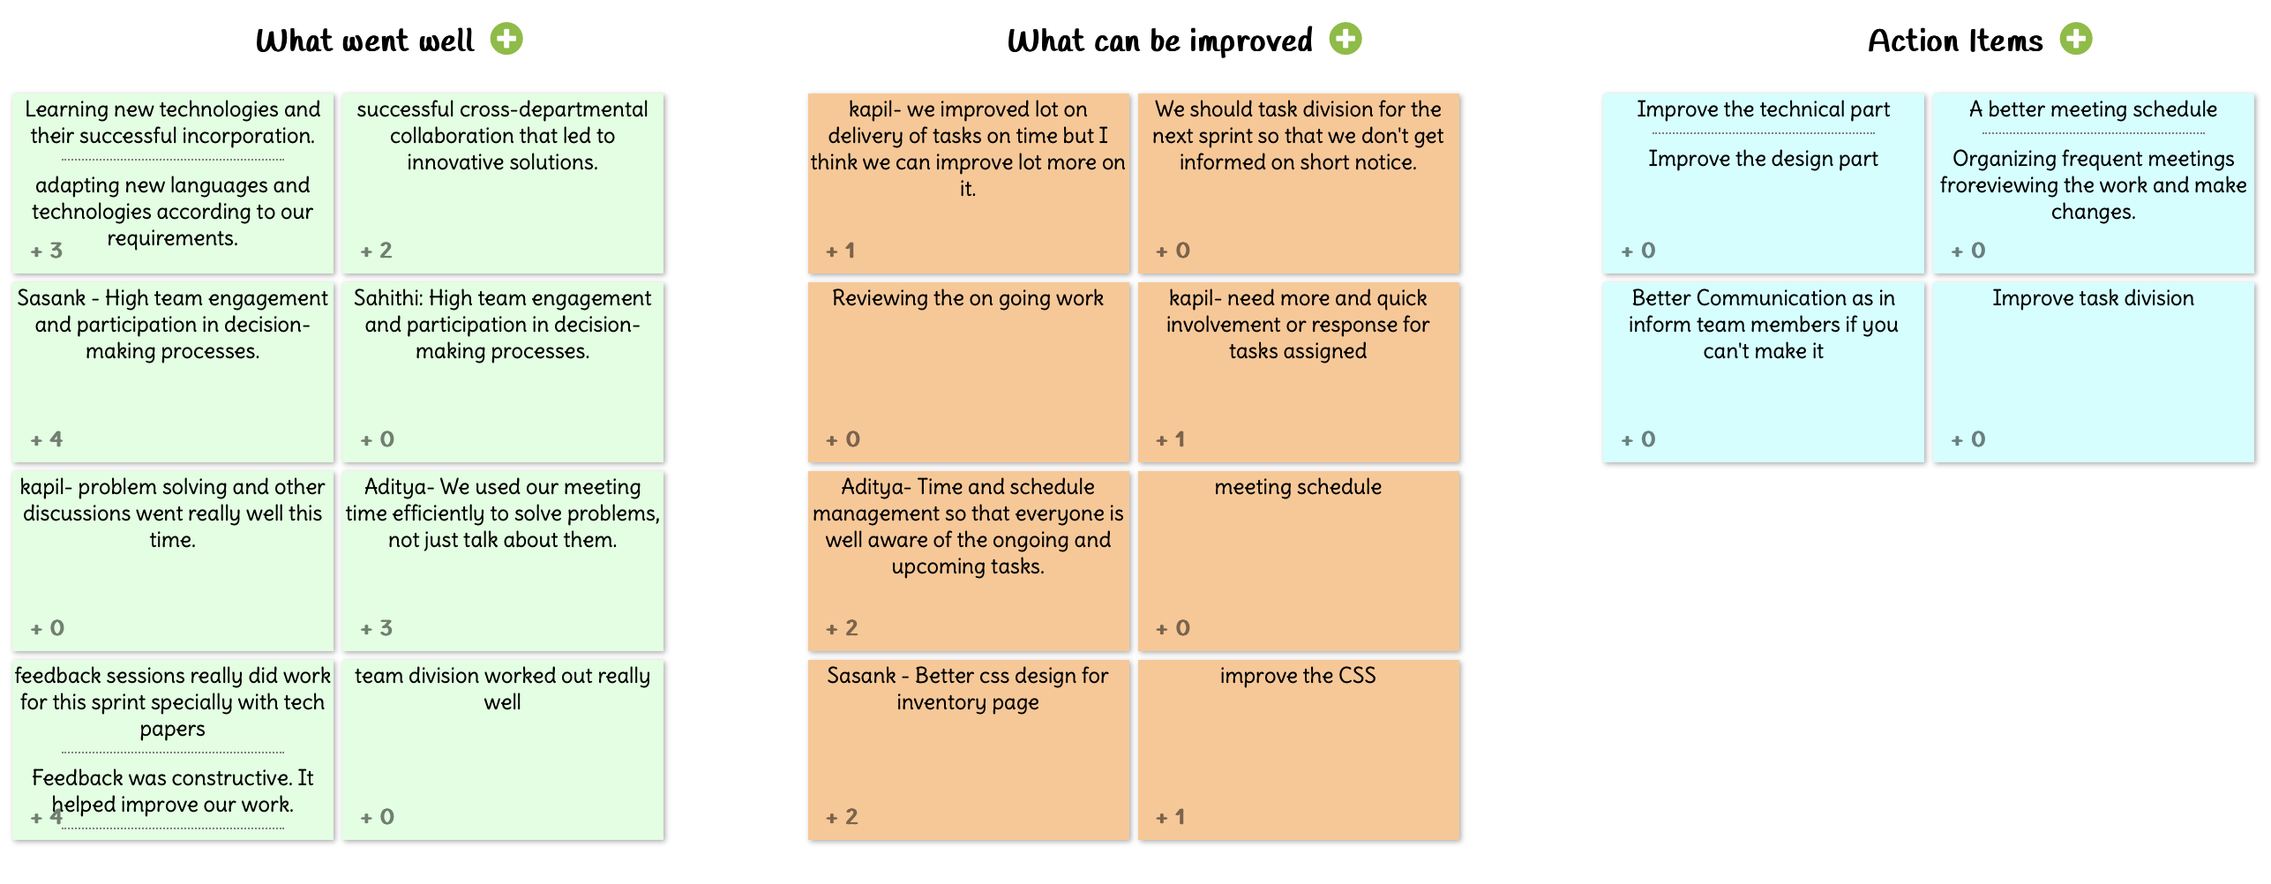
Retrospective – Sprint 3
20

Slide 44
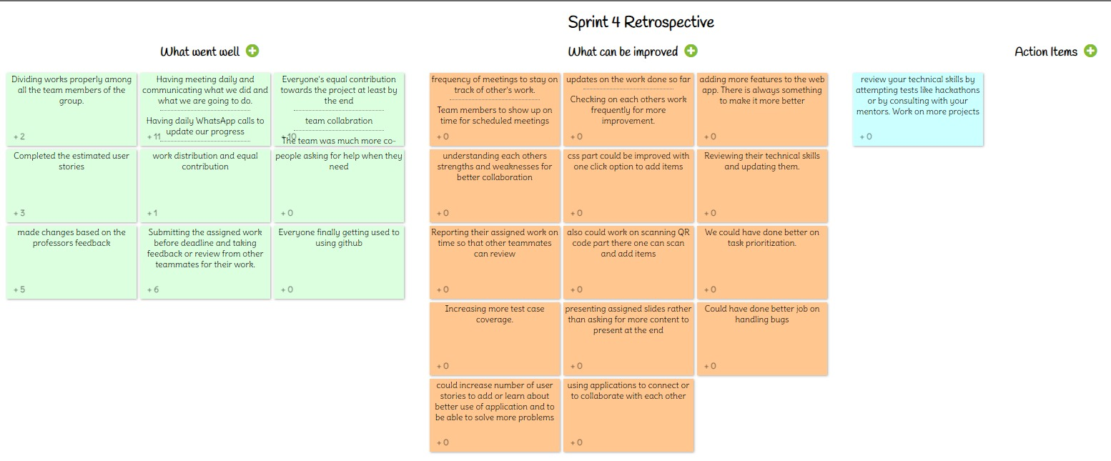
Retrospective – Sprint 4
20

Slide 45
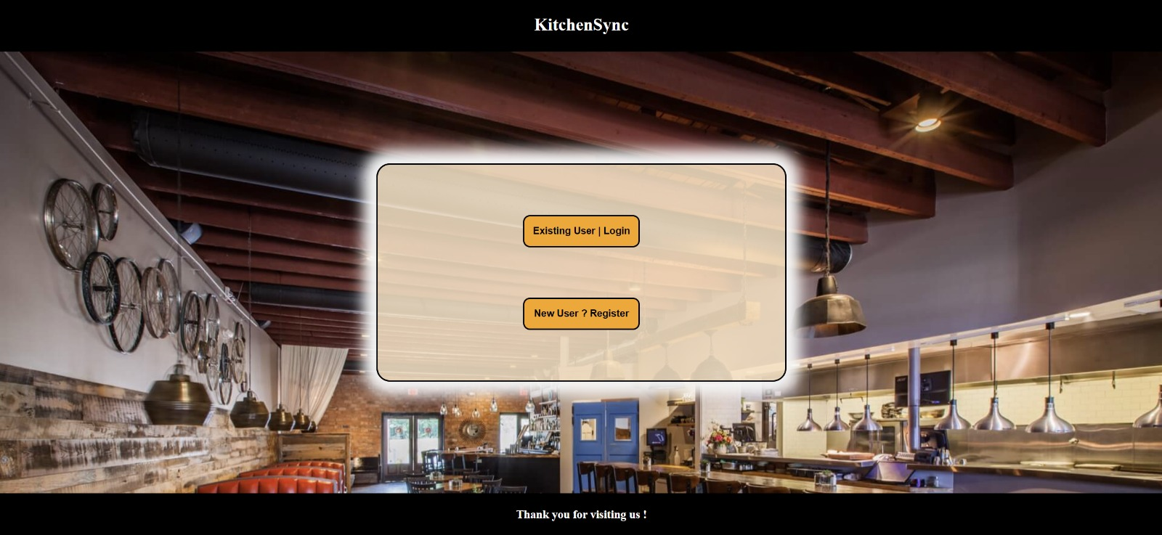
Webapp Screenshots
21

Slide 46
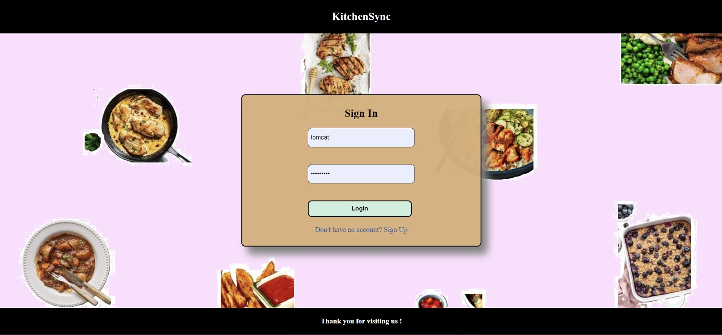
Webapp Screenshots

Slide 47
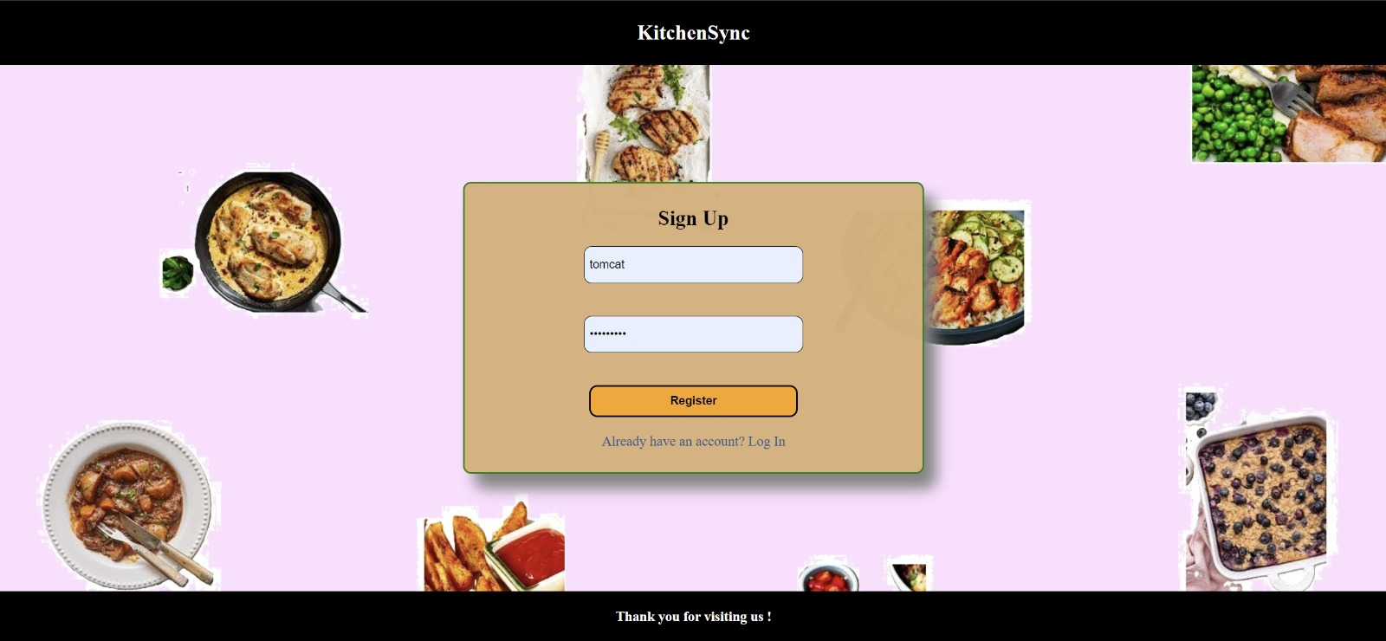
Webapp Screenshots

Slide 48
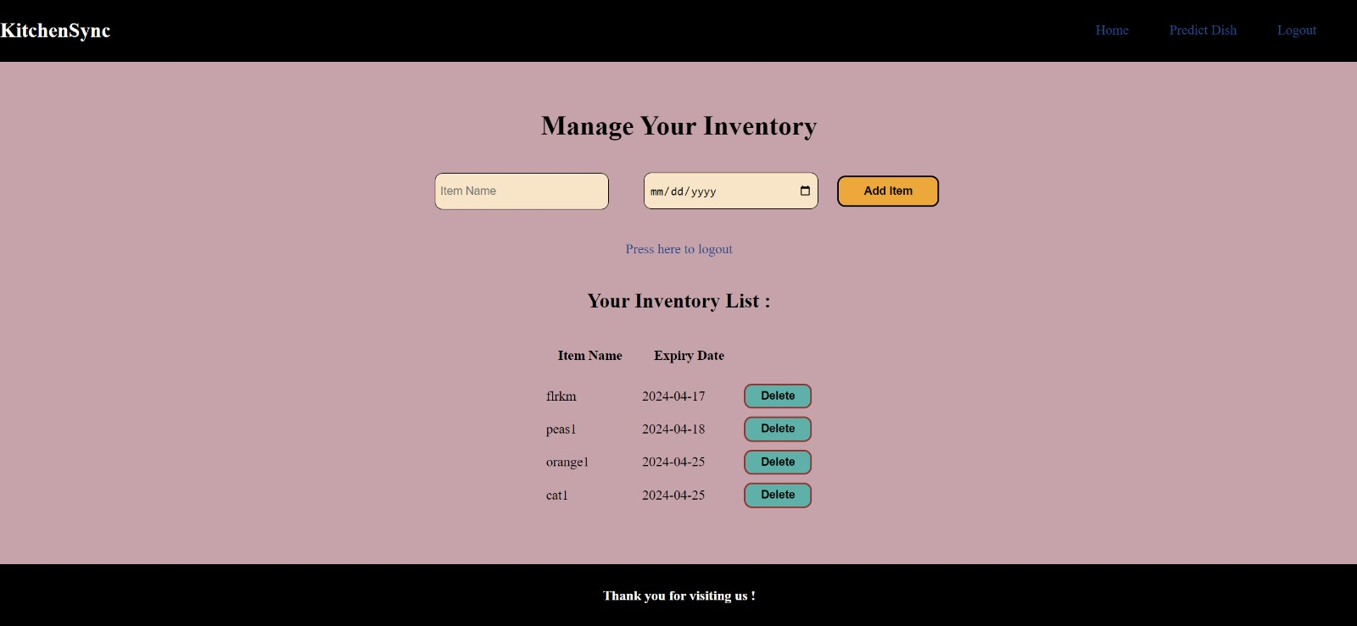
Webapp Screenshots

Slide 49
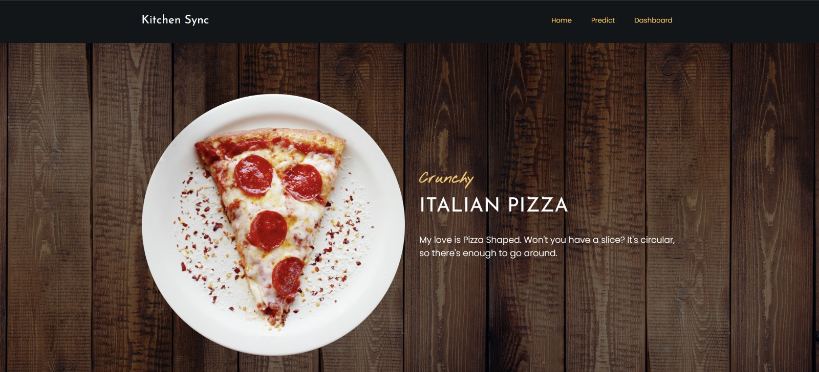
Webapp Screenshots

Slide 50
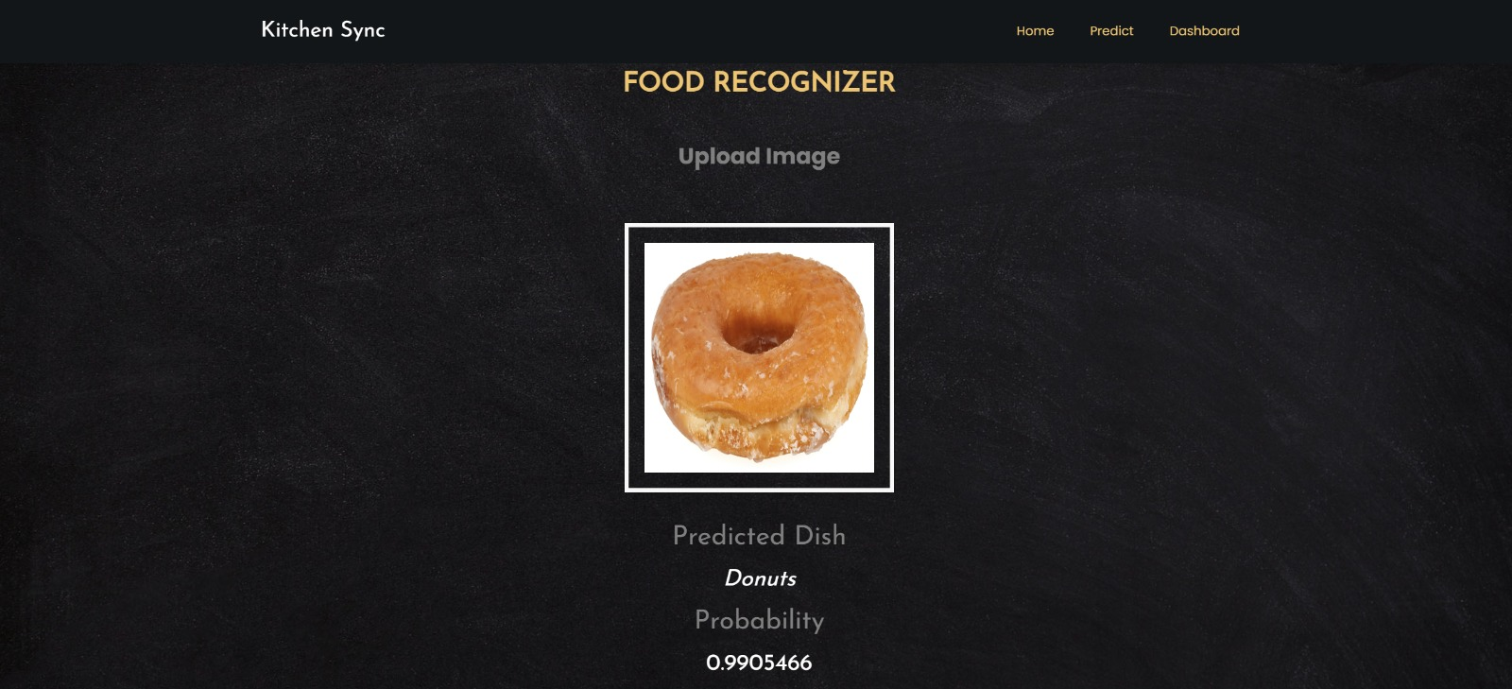
Webapp Screenshots

Slide 51
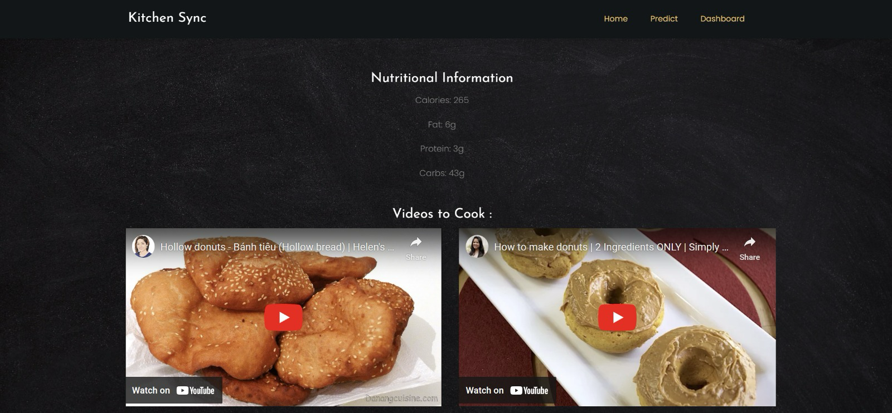
Webapp Screenshots

Slide 52


GITHUB:https://github.com/htmw/2024S-neon-nomads
22

Slide 53





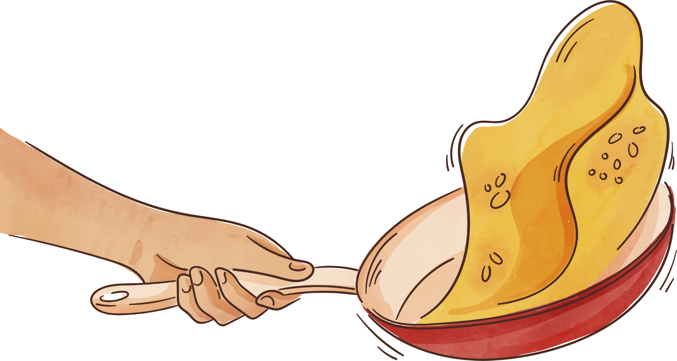
Live App Demo
23

Slide 54
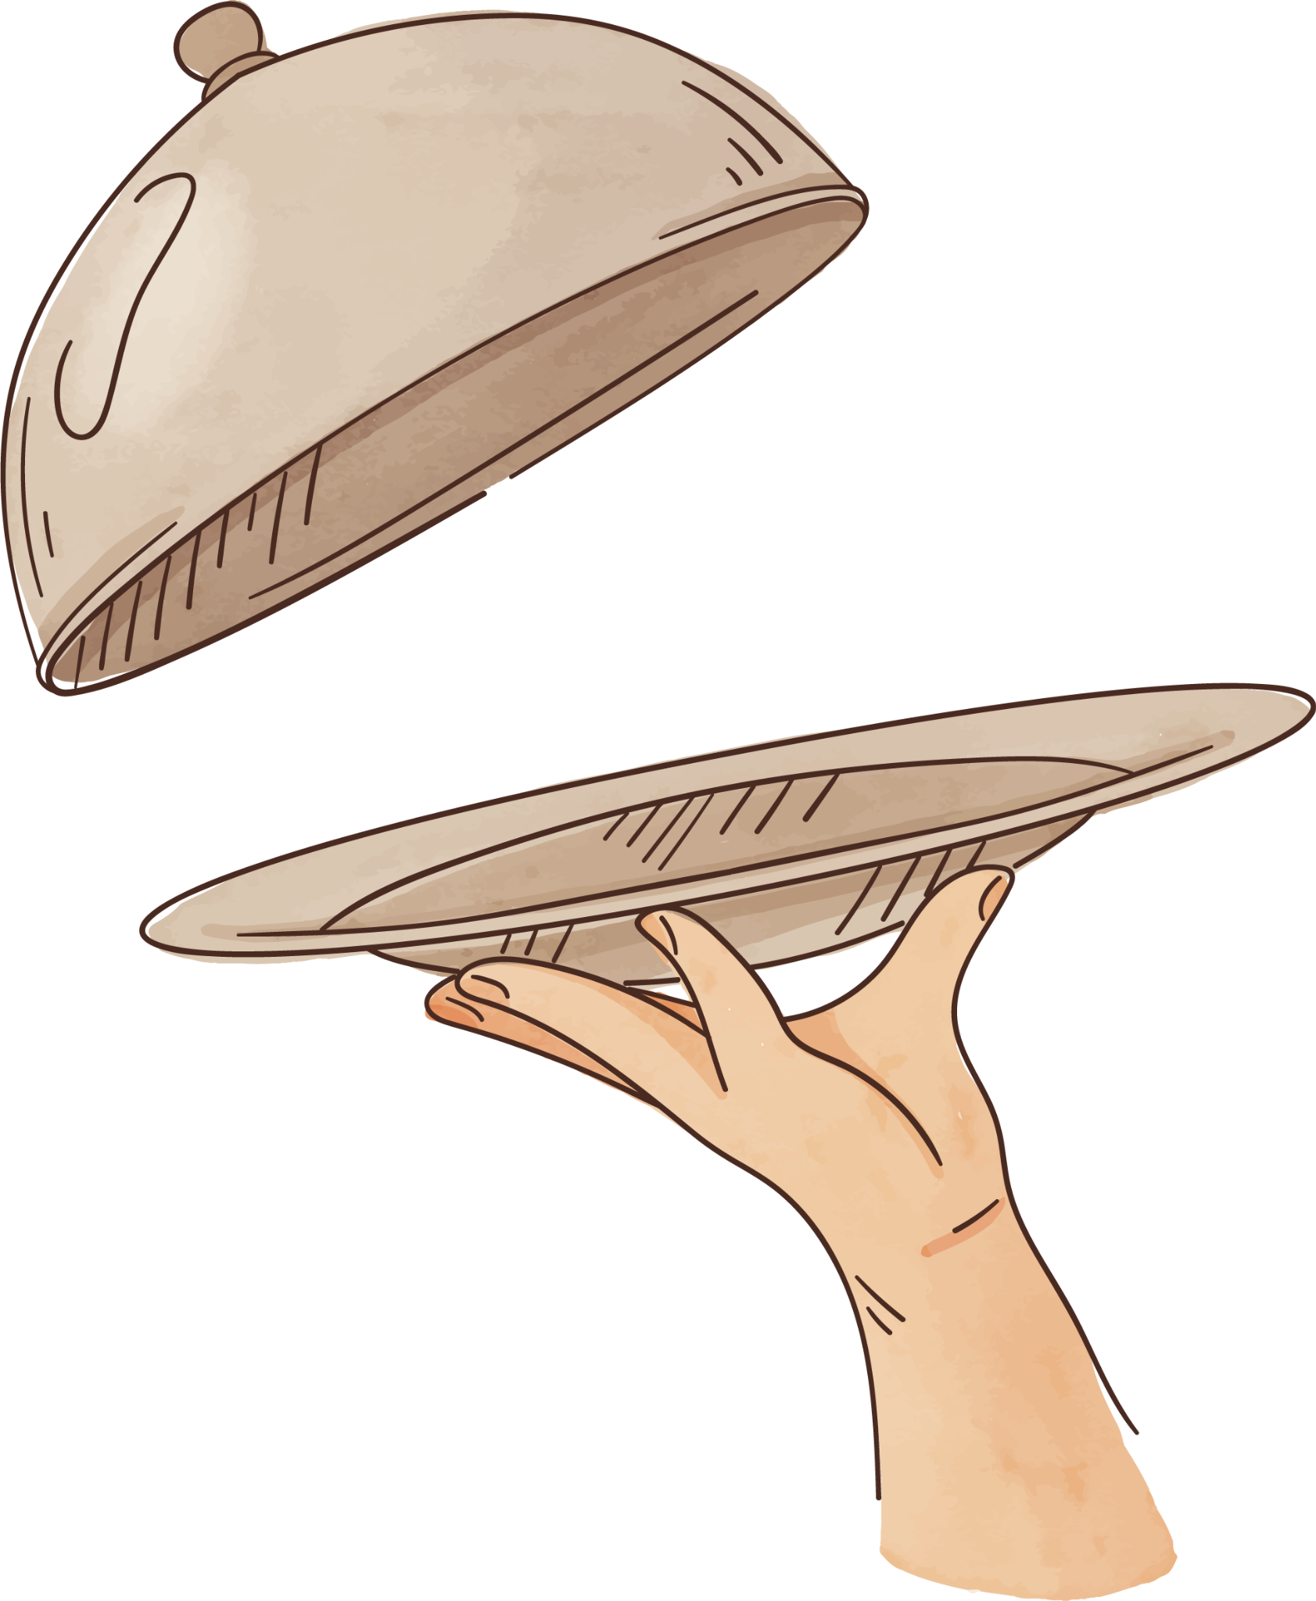

Bon Appétit!
Thanks

